Slide 1
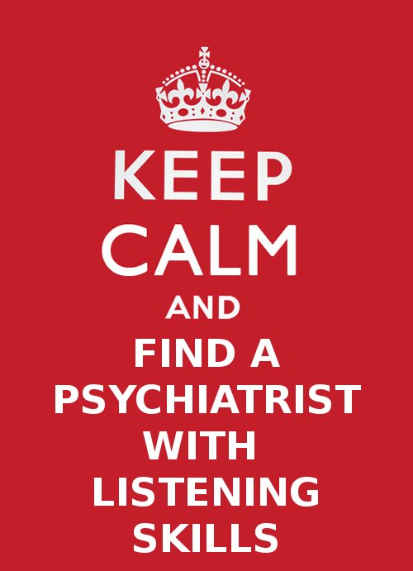
FUNCTIONAL
CONTEXTUAL
PSYCHIATRIST

Slide 2
ACT on Drugs Functional Contextual Pharmacology
Dr Robert Purssey MBBS FRANZCP
Functional Contextual Psychiatrist ☺
Clinical Senior Lecturer, Uni of Qld
Brisbane ACT Centre, Queensland

Slide 3
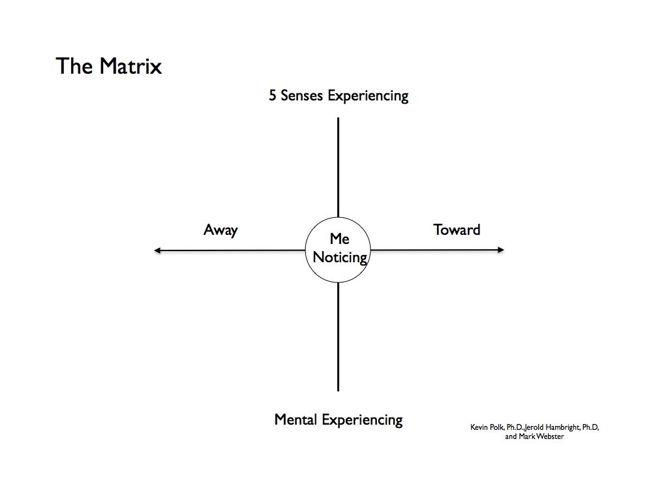

Slide 5
MOVING TOWARDS WORKABLE MEDICATION USE - TOGETHER
What is important to you and your clients?
What medication-related obstacles get in the way for you and them?
What do you and your clients do to move Away from these medication-related obstacles?
Can Functional Contextual Pharmacology help?
What can we and our clients do to move Toward those things important to us and them?
Notes:
For clinicians, these are perhaps the most immediately useful applications of this material.

Slide 7
Functional Contextual Pharmacology
CBS - Seamlessly consistent with ACT
Functionally informed medication use
Enabling workable, wise medication use
Things that you’re liable
To read in the (psychiatric) bible
Ain’t necessarily so…

Slide 8
Behavioral Pharmacology – 1950’s
J. R. Pappenheimer, B. F. Skinner, and P. B. Dews
Notes:
I find this picture quite inspirational, as it represents the sort of confluence of rigorous, seminal science at Harvard University in the 1950’s.
B.F. Skinner is well known to all as the psychological scientist whose astonishing radical behaviorism forms the foundations of modern contextual behavioral science – CBS, RFT, ACT.
J.R. Pappenheimer was a physiologist at Harvard who discovered, intensively researched and published the basis for the ubiquitous key physiological phenomenon of osmosis, eg Pappenheimer, J. R. et al. Filtration, diffusion and molecular sieving through peripheral capillary membranes. Am. J. Physiol. 167: 13-46, 1951
P.B Dews will, I hope, become well known to you all as the father of behavioral pharmacology – and here is a nice account of his arrival at Harvard, and his connection to Skinner…
Dews was hired to the post of Instructor in Pharmacology at Harvard Medical School in January 1953 by Professor Otto Krayer, and spent the remainder of his academic career at Harvard. Krayer told Dews to call on B. F. Skinner in the Department of Psychology at Harvard University, who had told Krayer that he (Skinner) had techniques that would be useful in pharmacology.(!!☺!!) The results of that meeting were colorfully recounted by Dews at a meeting of the European Behavioural Pharmacology Society (Dews, 1997). Dews met briefly with Skinner, and was then shown around the laboratory by Skinner's younger associate, C. B. Ferster. As Dews tells the story, he immediately felt at home in the laboratory; he sensed that he had found what was needed to objectively study the behavioral effects of drugs. The functional character of the laboratory was more like a physiology or pharmacology laboratory than what he had expected from a psychology laboratory. The likely leading contribution to his comfort with the laboratory environment was the kymograph-like tracings of the cumulative recorders drawing records of behavior occurring in time, and in systematic relation to environmental events.
Dews and Ferster immediately launched studies on the behavioral effects of drugs, some of which were published in Ferster and Skinner's compendium, Schedules of Reinforcement (Ferster and Skinner, 1957)…
Finally for historical viewpoint linking the above, pointing to just how important these 3 scientists remain, here is a very cool and telling quotation from PB Dews 1963:
In emphasizing the importance of schedules it is not intended to imply that all of psychology should be reduced to a study of them. An influence can be all pervading without being all embracing. No one would maintain that all mechanisms of physiology can be reduced to the laws of osmosis; yet osmotic phenomena are ubiquitous in physiology; whenever they can operate, they do; and the student of any physiological mechanism ignores osmosis at his peril. Similarly, it is suggested that schedule influences operate generally in psychology; that when these influences can operate, they will; and that a student of any problem in psychology - whether it be motivation, generalization, discrimination or the functions of the frontal lobes - ignores the consequences of the precise scheduling arrangements of his experiments at his peril. (pp 8-9)
Dews' (1963) comparison of reinforcement schedules in behavioral pharmacology to osmosis in physiology remains as valid and relevant today as it was when he originally made the observation. Although we cannot explain all behavior, or all effects of drugs on behavior by reference to the environmental contingencies of reinforcement, whenever contingencies of reinforcement can influence behavior they will.
Dews PB (1963) Behavioral effects of drugs. In: Farber SM, Wilson RHL (eds) Conflict and creativity, control of the mind, part 2. McGraw-Hill, New York
BY 1955 DEWS HAD PUBLISHED THE FIRST AND STILL CRITICALLY IMPORTANT EXPERIMENTAL FINDING FROM THE HARVARD PSYCHOBIOLOGY LABORATORY (see also following slides ) → I’ve highlighted critically important details…
Dews, P.B. Studies on behavior. I. Differential sensitivity to pentobarbital of pecking performance in pigeons depending on the schedule of reward. 1955 J Pharmacol Exp Ther 138:393-401
In this seminal paper and in the several that followed, Dews and his colleagues applied techniques and concepts adapted from the behavioral psychology of B.F. Skinner to develop a functional analysis of the behavioral effects of drugs.
Rather than appealing to hypothetical constructs representing internal psychological processes inferred from and having meaning beyond the behavioral observations, Skinner and colleagues examined the functional relationships between the organisms' behavior and the environment. The methods and analyses of behavior utilized by Skinner emphasized these relationships between behavior and, in particular, its consequences. These relationships between behavior and its consequences were referred to as schedules of reinforcement (Ferster and Skinner 1957).
The exclusion of hypothetical constructs based on their lack of reducibility to functional relations between behavior and its environmental determinants is arguably the most important distinction between the formulations of Skinner and those of the learning theorists of his day. Hypothetical constructs are of two types, those that are potentially verifiable, e.g. events taking place in the CNS that relate to behavior, and those that are metaphorical, e.g. those that are exclusively heuristic, "explaining" behavior with models that cannot be seriously believed because of other knowledge (MacCorquodale and Meehl 1948).
The former (potentially verifiable) certainly have their place in a science that relates behavior to neurobiology. However, as noted by Skinner, this type of construct is not necessary for a pure science of behavior (i.e. one that deals exclusively with functional relations between behavior and its environmental determinants), and the science of behavior can be complete without these. Metaphorical constructs, on the other hand, can have a heuristic benefit, but they also have the potential of generating circular explanations whereby the causes of behavior are "explained" by the constructs from which they are inferred. Most problematic is that an approach employing constructs directs attention away from the actual determinants of behavior.
Much of the above account is from the truly excellent article (which best covers this material of anything I’ve yet read):
McMillan, D.E. and Katz, J.L. Continuing implications of the early evidence against the drive-reduction hypothesis of the behavioral effects of drugs. Psychopharmacology 2002
Wherein these important references (per above):
Ferster, C.B. and Skinner, B.F. Schedules of Reinforcement . Appleton-Century-Crofts, New York (1957).
MacCorquodale K, Meehl PE (1948) On a distinction between hypothetical constructs and intervening variables. Psychol Rev 55:95-107
Oh, and they all 3 had fun, enjoyed teaching, and wrote significantly about their lives outside Academe, i.e. We knew about various aspects of their controlling varialbles ☺

Slide 9
Functional Contextual vs Mechanist
Functional
Contextual
Pharmacology
Mechanist
Cognitivist Psychopharmacology
Notes:
Credit to Chad Drake “getting behavioral about ACT” lectures for diagram

Slide 10
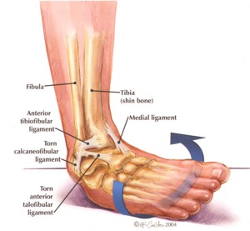
Functional contextual analysis
Decontextualised Mechanistic analysis

Slide 11
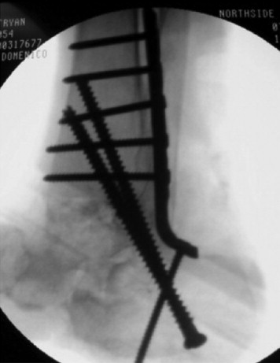
Functional contextual intervention
What’s true is what works… in relation to a specified direction or goal.
Mechanistic intervention
What’s true is what corresponds most closely to a measurable reality.

Slide 12
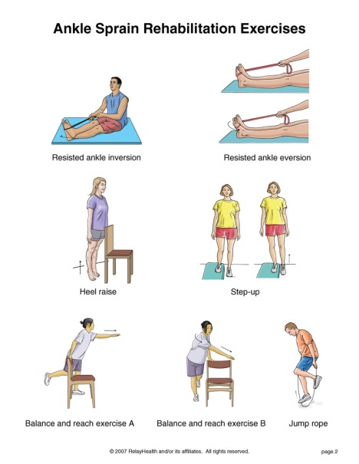
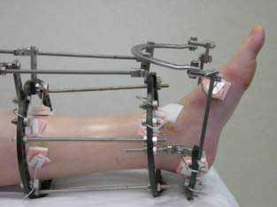
Functional contextual treatment
What’s true is what works…
...Towards valued living
DSM / syndromal treatment
Less difficult feelings and thoughts
Less items on checklists of troubles

Slide 13
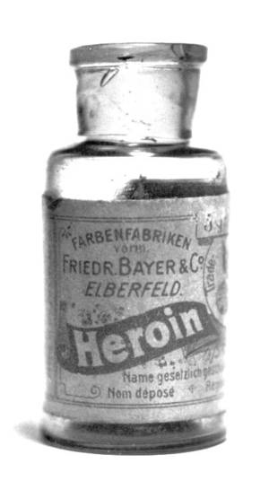
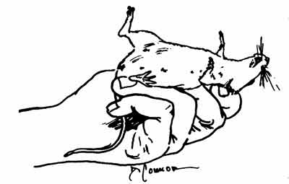
Context & heroin: rats
Lethality of heroin in 3 groups:
2 tolerant (colony VS white noise), 1 control
LETHAL DOSE GIVEN:
96% lethality - Control
64% lethality - NEW envt CF tolerance
32% lethality - SAME envt as tolerance

Slide 14
CONTEXT & heroin - rats & humans
Siegel et al. 1982 “Heroin ‘overdose’ death:
Contribution of drug-associated Environmental cues.” Science.

Slide 15
Situational Specificity of Tolerance
Overdose deaths in humans due to:
Opioids
Alcohol
Pentobarbital
Understanding / Preventing Overdoses clinically
→ … 3 human OD’s reflected this mechanism, as these patients normally did not inject on staircases / toilets
Deaths of heroin users in a general practice population. Bucknall and Robertson, J R Coll Gen Pract. 1986

Slide 16
Functional contextual treatment
What’s true is what works…
...Towards valued living
DSM / syndromal treatment
Fewer difficult feelings and thoughts
Decreases in items on symptom lists

Slide 17
Trends in psychotropic meds
in Australia: 2000 - 2011
Stephenson et al, Aust N Z J Psychiatry 9.11.2012
ANTIDEPRESSANTS DOUBLED
“ATYPICAL” ANTIPSYCHOTICS TRIPLED
ADHD MEDS DOUBLED
XANAX DOUBLED
LAMOTRIGINE DOUBLED
AND AUSTRALIAN’S MENTAL HEALTH?
NO IMPROVEMENT
Changes in psychological distress in Australian adults 1995 - 2011.
Jorm and Reavley, Aust N Z J Psychiatry 2012

Slide 18
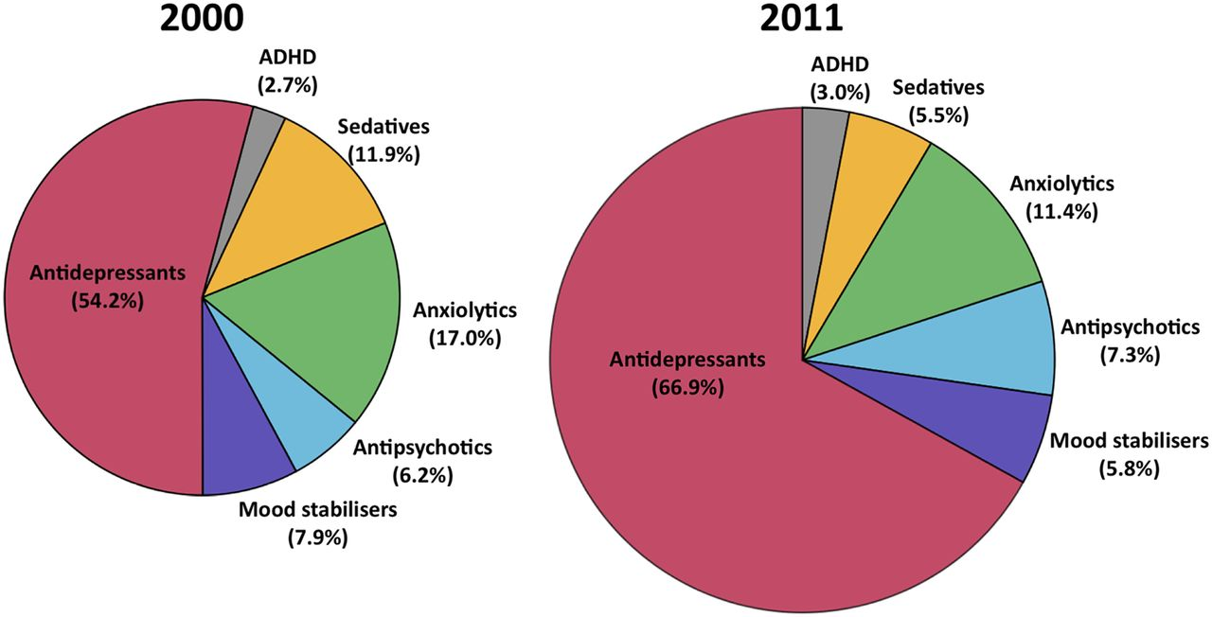
Trends in psychotropic meds in Australia 2000 to 2011
Figure 1. Share of market (DDD/1000 population/day) per class
Notes:
Pie charts showing the share of the market (in terms of DDD/1000 population/day) for each psychotropic class in 2000 and 2011. Note the 2011 figure is 58% larger in area to graphically represent the growth in the psychotropic drug market as a whole.

Slide 19
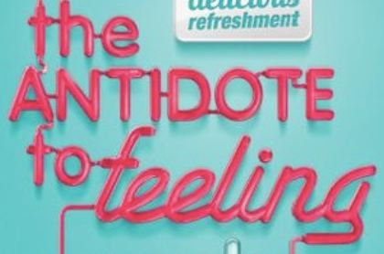
DSM depression … depressed mood most of the day..
DSM anxiety - …excessive anxiety…

Slide 20
Emotional Side-effects of Antidepressants
Price J… Goodwin G. Journal of Affective Disorders 2012
Because I don’t care so much, I’m having problems at home
I don’t have the same passion and enthusiasm for life
Other people being upset doesn’t affect me
Because I don’t care so much, I’m having problems at work or college
Day to day life doesn’t have the same emotional impact
I don’t react to other people’s emotions as much
I don’t care as much about my day to day responsibilities
I just don’t care about things as much as I did

Slide 21
Emotional Side-effects of Antidepressants
Percentage of emotional side effects overall
207 participants
26% no emotional side-effects
16% insignificant emotional s/e
30% mild
23% moderate
6% severe emotional s/e’s
Participants with emotional side-effects
younger
higher BDI-II scores
shorter treatment duration.

Slide 22
Data Based Medicine - health warning
Doctors most persuaded people on earth
Many resist company adverts / free lunches
Unaware that trials / guidelines are advertisements
Guidance / awareness will shock many doctors
Clever marketing -> many feel personally attacked
No-one should have to cope with present uncertainties
RxISK papers are disturbing – think twice before reading

Slide 23
DBM Position Paper - Antidepressants
1000’s publications, over 1000 trials
50-­90% ghost-written
40‐50% of studies unpublished
30% of POSITIVE studies actually NEGATIVE
Risks are not published
www.rxisk.org – research papers

Slide 24
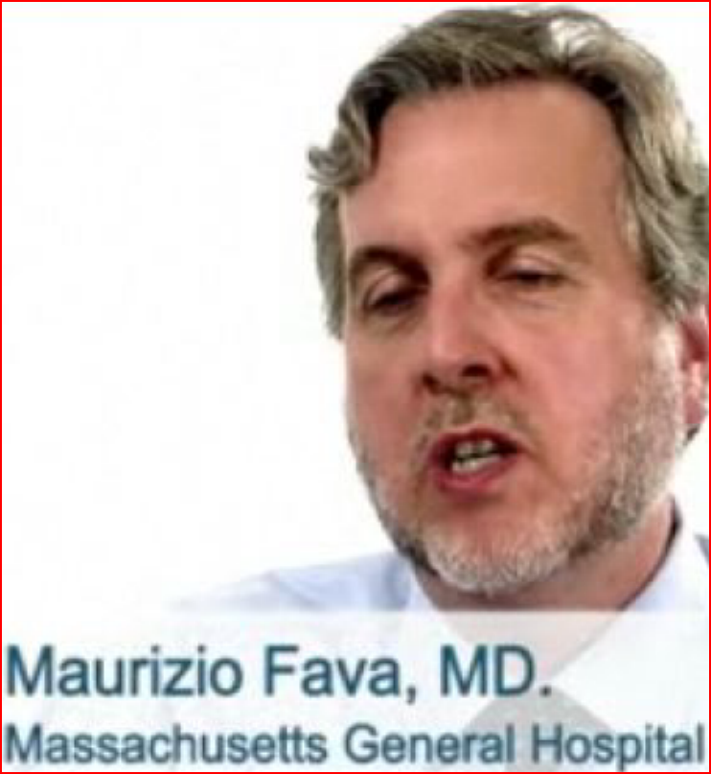
STAR D, NIMH published V real results
"The overall cumulative remission rate was 67%“
But closer review found…
4041 started, 108 remitted, the rest either relapsed and/or dropped out → remission rate 2.7%
“I think their analysis is reasonable and not incompatible with what we had reported“

Slide 25
DBM on Guidelines for Antidepressants
Published trials of “good quality”?
Almost all only a few weeks
No quality of life measures
Scales improve with side effects
RECOGNIZED GUIDELINES?
None score Quality Mark > 1 /10
Independent guidelines superior?
-> identical HENCE more dangerous
COCHRANE?
Sertraline
Antidepressants for children
Tamiflu

Slide 26
THERE IS NO CHEMICAL IMBALANCE
40 years of neurotransmitter theories – NO EVIDENCE
“NO serotonin or norepinephrine deficiency”
Professor of Neuroscience E.Valenstein
“…there is no “real” monoamine deficit”
Psychopharmacologist Stephen Stahl
“NO simple neurochemical explanations”
Kenneth Kendler
“Antidepressants affect processes unrelated to the pathology of depression”
Krishnan and Nestler, AJP in press 2010

Slide 27
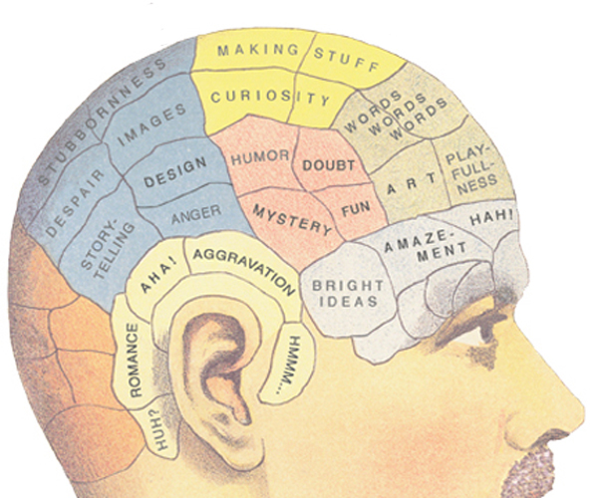
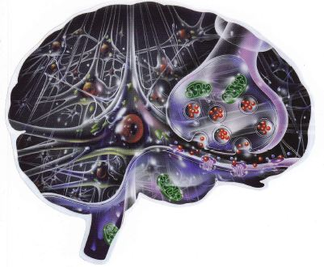
OLD and NEW BIOMYTHOLOGIES

Slide 28
Functional Contextual Therapy AND Pharmacology
• Not “FIXING” thoughts and feelings
… or chemistry and biology
Functional contextual view of behavior
… of biology
… of medications
Destructive normality

Slide 29
Flexible, pragmatic pharmacology
Let go of DSM
except where necessary ☺
Drop “symptoms” … “illness”… “symptom removal”
→ especially “remission is the goal”
Frees from experiential struggle
→ overmedicating / chronicity
Meds “Toward valued living
… edge off so as to do stuff”
Meds “Away from unwanted experiencing
… ridding bad feelings / thoughts”

Slide 32
ACT on Drugs Resources Functional Contextual Pharmacology
Email “ACT on Drugs 2012 Matrix Sorting” to robpurssey@gmail.com – also www.davidhealy.org
www.rxisk.org Join! & Research Papers at bottom
ACT on Drugs 2011 – Log into ACBS site, Videos The 5th Australian and New Zealand ACT Conference → Day 3, Stream 3, 2-5pm in 2 parts. Also highly relevant is Functional Contextual Neuroscience Day 1, Stream 4, 10am
Contextual Medicine SIG via ACBS site
Healthy Skepticism – JOIN! and contribute
Anatomy of an Epidemic, and Whitaker’s site

